Slide 8
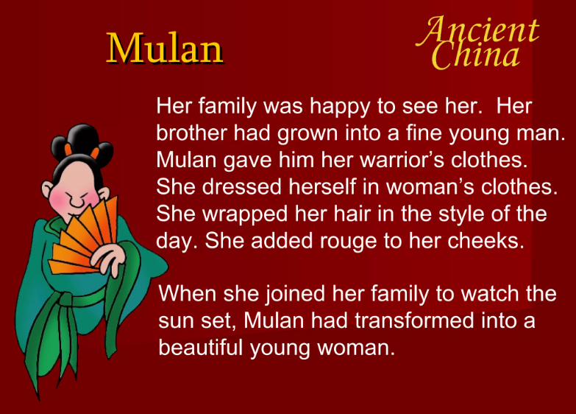

Slide 10
Theme
What is the theme of the Ode of Mulan?
The Ode of Mulan also shows elements of Chinese traditional culture as Mulan has the qualities of respecting the old and loving the young. It is the expectation of Chinese society that women fulfill their filial piety. Mulan is not greedy for fame and she has optimistic and brave patriotism.

Slide 11
Symbolism
The Ballad reaffirms traditional family values and a sense of gender equality because it narrates a story of a woman being celebrated for being dutiful to her emperor and to her father, highlighting Confucian values. At the end of the Ballad, Mulan resumes her duty as a daughter.

Slide 12
Onomatopoeia –
Onomatopoeia is used to imitate and express the sound something makes. For instance, the ballad starts with the sound of Mulan weaving, “tsiek tsiek,” showing the women’s pastime in early China. There are also sounds of nature like “Yellow River’s flowing water cry “tsien tsien,” or horses’ galloping noise “tsiu tsiu”. All the onomatopoeias begin with the same letters’ t’ and’s,’ which gives a sense of Chinese words since there are many ‘ts’ sounds in the language. The melody of the poem is also displayed through the implication of alliteration. Several lines start with the same words, such as “you,” “they,” “no one,” “in the,” “she buys,” and so on. These techniques transform the sound effects and atmosphere of the work and make it more real.
Nithya Prakash /FACULTY/English/SNSACD

Slide 14
Use of imagery to convey the scenery of the battlefield and Mulan’s journey. The words in lines, “Northern gusts carry the rattle of army pots, chilly light shines on iron armor,” describe the feeling of being in the war field.
There are also uses of similes, such as “she crosses passes and mountains like flying,” which help depict the heroine’s abilities as a warrior.
symbolism plays a significant role in identifying the mood and tone of the story. For example, the use of colors indicates the movement from one place to another. In the ballad, Mulan leaves the Yellow River, which stands for her home, and directs to the Black Mountains, meaning the battlefield. When she returns home from war, Mulan dabs her face in yellow powde. It signifies the arrival to her birthplace and the change of war theme to a peaceful tone.
Nithya Prakash /FACULTY/English/SNSACD

